Slide 1

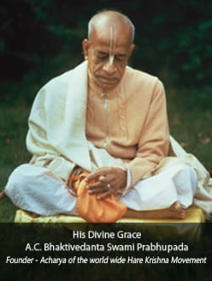

Hare Krishna, welcome please sign up to chant and hear the holy name, Haribol!
Continue with Google

Slide 2
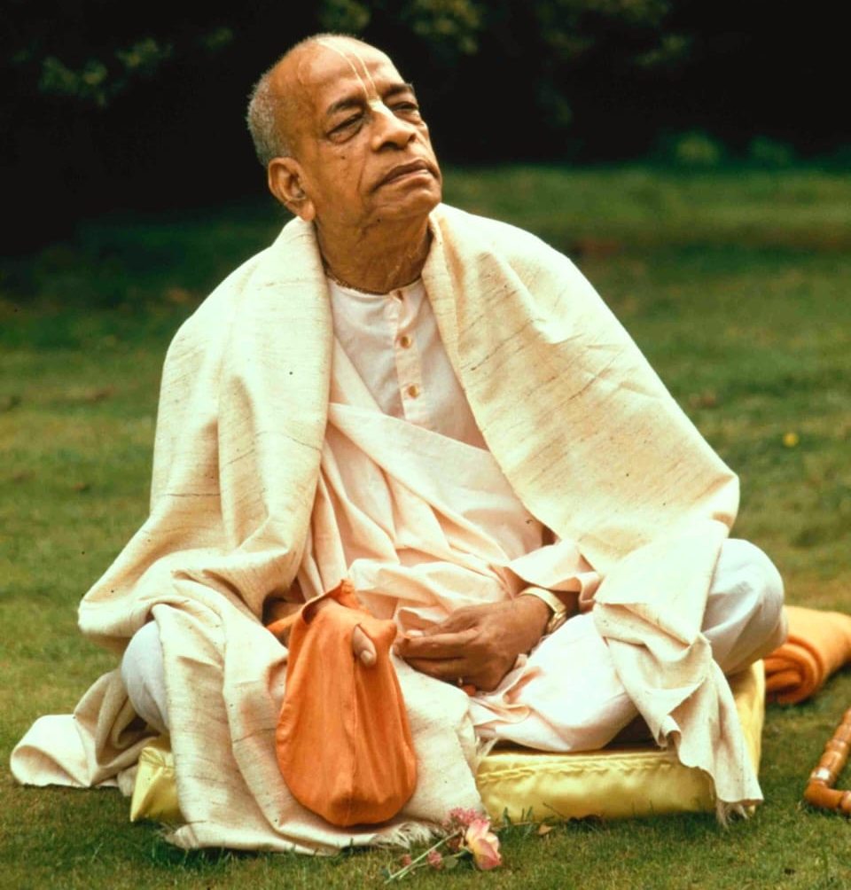
Dedicated to His Divine Grace
A.C.Bhaktivedanta Swami Prabhupada
Founder - Acharya of the world wide Hare Krishna Movement
“
By Srila Prabupada,
The name Krishna and the Supreme Person Krishna are non-different.
Therefore, if one concentrates his mind on hearing and chanting Hare Krishan, The Same Result is Achieved."
Hare Krishna, Welcome to
Chant and Hear App.
Please sign up to experience and enhance your chanting skills.
Continue with Google

Slide 3
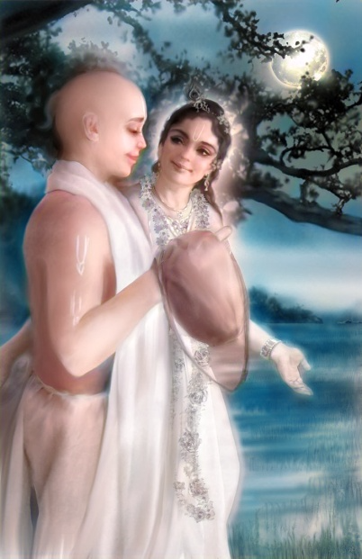
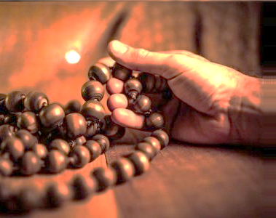
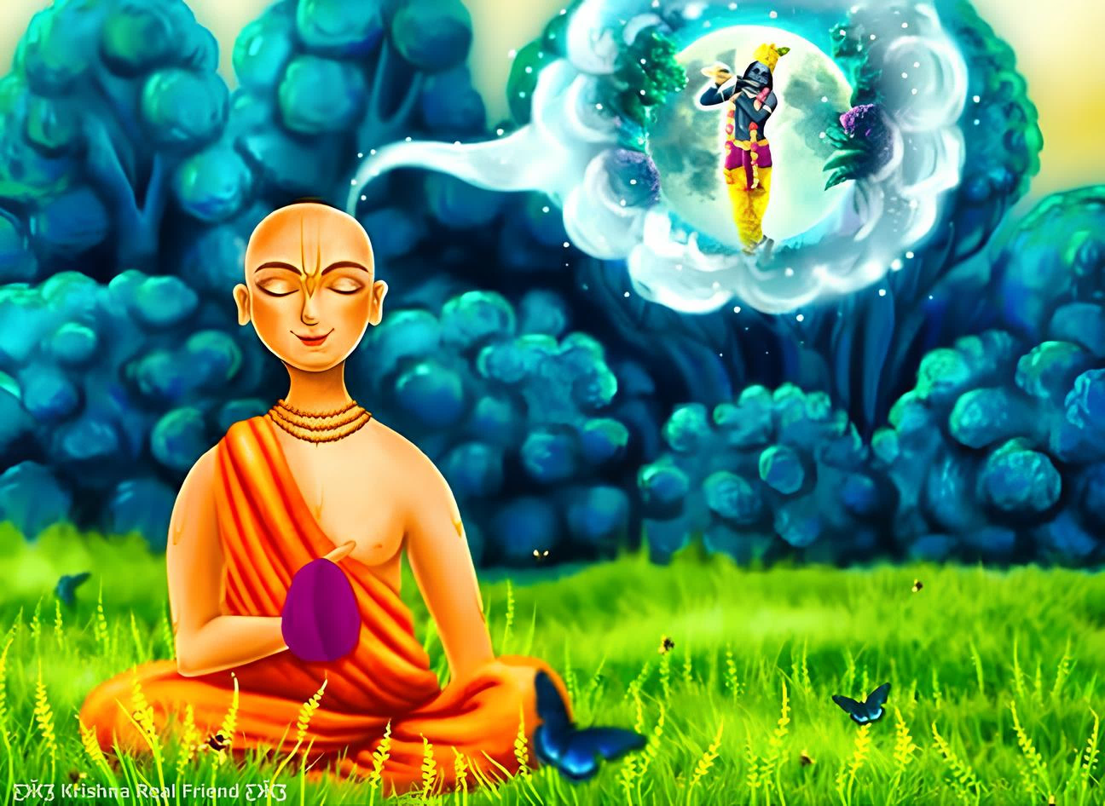

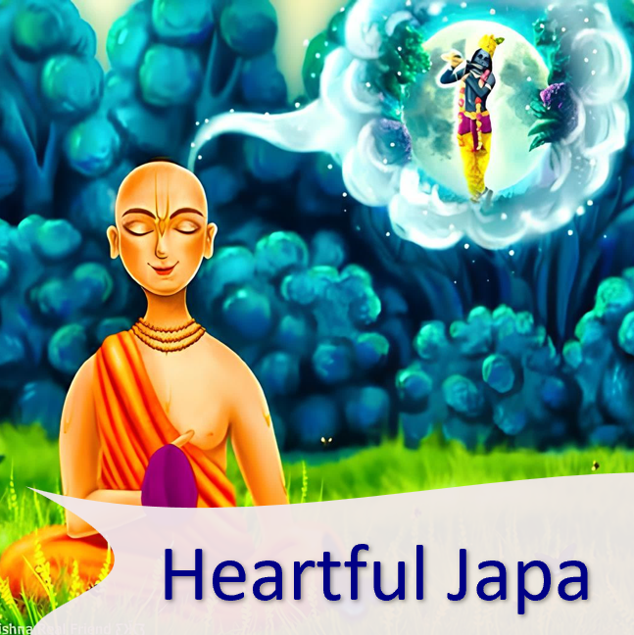

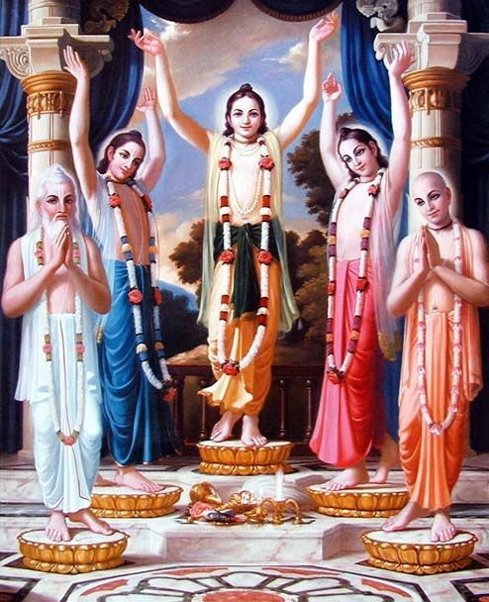
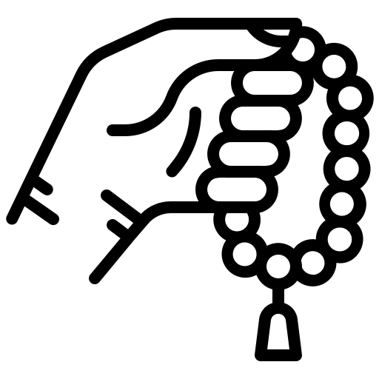
Mindful Japa
Heartful Japa
Soulful Japa
Dedicate to His Divine Grace
A.C.Bhaktivedanta Swami Prabhupada
Founder - Acharya of the world wide Hare Krishna Movement

Slide 4

01
Heard
67
Time take
06:18 min
02
Heard
45
Time take
07:38 min
03
Heard
78
Time take
05:45 min
04
Heard
35
Time take
08:05 min
05
Heard
90
Time take
05:56 min
06
Heard
78
Time take
06:23 min

